Slide 1
CS 152 Computer Architecture and Engineering CS252 Graduate Computer Architecture Lecture 14 – Multithreading
Krste Asanovic
Electrical Engineering and Computer Sciences
University of California at Berkeley
http://www.eecs.berkeley.edu/~krste
http://inst.eecs.berkeley.edu/~cs152

Slide 2
Last Time Lecture 13: VLIW
In a classic VLIW, compiler is responsible for avoiding all hazards -> simple hardware, complex compiler.
Later VLIWs added more dynamic hardware interlocks, which reduce relative hardware benefits
Use loop unrolling and software pipelining for loops, trace scheduling for more irregular code
Static scheduling difficult in presence of unpredictable branches and variable latency memory
VLIW has failed in general-purpose computing, but still used in deeply embedded processors and DSPs

Slide 3
Thread-Level Parallelism (TLP)
Difficult to continue to extract instruction-level parallelism (ILP) from a single sequential thread of control
Many workloads can make use of thread-level parallelism:
TLP from multiprogramming (run independent sequential jobs)
TLP from multithreaded applications (run one job faster using parallel threads)
Multithreading uses TLP to improve utilization of a single processor

Slide 4
Multithreading
How can we guarantee no dependencies between instructions in a pipeline?
One way is to interleave execution of instructions from different program threads on same pipeline
Interleave 4 threads, T1-T4, on non-bypassed 5-stage pipe
t0
t1
t2
t3
t4
t5
t6
t7
t8
t9
T1:LD x1,0(x2)
T2:ADD x7,x1,x4
T3:XORI x5,x4,12
T4:SD 0(x7),x5
T1:LD x5,12(x1)
F
D
X
M
W
Prior instruction in a thread always completes write-back before next instruction in same thread reads register file
F
D
X
M
W
F
D
X
M
W
F
D
X
M
W
F
D
X
M
W

Slide 5
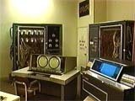
CDC 6600 Peripheral Processors (Cray, 1964)
First multithreaded hardware
10 “virtual” I/O processors
Fixed interleave on simple pipeline
Pipeline has 100ns cycle time
Each virtual processor executes one instruction every 1000ns
Accumulator-based instruction set to reduce processor state
Notes:
Was objective was to cope with long I/O latencies?

Slide 6
Simple Multithreaded Pipeline
X
PC
1
GPR1
PC
1
I$
IR
GPR1
PC
1
GPR1
PC
1
GPR1
D$
Y
+1
2
Thread select
2
Have to carry thread select down pipeline to ensure correct state bits read/written at each pipe stage
Appears to software (including OS) as multiple, albeit slower, CPUs

Slide 7
Multithreading Costs
Each thread requires its own user state
PC
GPRs
Also, needs its own system state
Virtual-memory page-table-base register
Exception-handling registers
Other overheads:
Additional cache/TLB conflicts from competing threads
or add larger cache/TLB capacity
More OS overhead to schedule more threads (where do all these threads come from?)

Slide 8
Thread Scheduling Policies
Fixed interleave (CDC 6600 PPUs, 1964)
Each of N threads executes one instruction every N cycles
If thread not ready to go in its slot, insert pipeline bubble
Software-controlled interleave (TI ASC PPUs, 1971)
OS allocates S pipeline slots amongst N threads
Hardware performs fixed interleave over S slots, executing whichever thread is in that slot
Hardware-controlled thread scheduling (HEP, 1982)
Hardware keeps track of which threads are ready to go
Picks next thread to execute based on hardware priority scheme
Notes:
Software-controlled interleave, S > N. Wheel with the threads in each slot. If thread is ready to go
It goes, else NOP, I.e., pipeline bubble.
Biancolin: For students: benefits of software-controlled interleave?

Slide 9
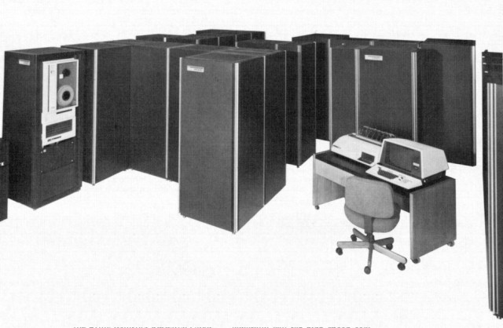
Denelcor HEP (Burton Smith, 1982)
First commercial machine to use hardware threading in main CPU
120 threads per processor
10 MHz clock rate
Up to 8 processors
precursor to Tera MTA (Multithreaded Architecture)
Notes:
Would be nice to add a slide on the implementation…

Slide 10
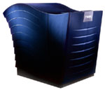
Tera/Cray MTA (1990-2015)
Up to 256 processors
Up to 128 active threads per processor
Processors and memory modules populate a sparse 3D torus interconnection fabric
Flat, shared main memory
No data cache
Sustains one main memory access per cycle per processor
GaAs logic in prototype, 1KW/processor @ 260MHz
Second version CMOS, MTA-2, 50W/processor
Newer version, XMT, fits into AMD Opteron socket, runs at 500MHz
Newer versions (2011), XMT-2, has higher memory bandwidth and capacity
Discontinued 2015?
Notes:
Biancolin:
Interconnect: 16 x 16 x 16 (4096 nodes)
XMT -> aka. Threadstorm (Max 8192 processors, 512 TB of memory)

Slide 11
MTA Pipeline
Issue Pool
Inst Fetch
Every cycle, one VLIW instruction from one active thread is launched into pipeline
Instruction pipeline is 21 cycles long
Memory operations incur ~150 cycles of latency
W
M
A
C
W
Write Pool
Memory Pool
W
Retry Pool
Assuming a single thread issues one instruction every 21 cycles, and clock rate is 260 MHz…
What is single-thread performance?
Effective single-thread issue rate is 260/21 = 12.4 MIPS
Interconnection Network
Memory pipeline
Notes:
Memory unit is busy, or sync operation failed retry.
Just goes around the memory pipeline.
Biancolin notes:
Lookahead -> specify number of instructions later load data will be used (hide memory latency; esp. when we don’t have 128 threads)

Slide 12
Coarse-Grain Multithreading
Tera MTA designed for supercomputing applications with large data sets and low locality
No data cache
Many parallel threads needed to hide large memory latency
Other applications are more cache friendly
Few pipeline bubbles if cache mostly has hits
Just add a few threads to hide occasional cache miss latencies
Swap threads on cache misses
Notes:
Tera --- 256 mem-ops/cycle * 150 cycles/mem-op = 38K instructions-in-flight…
Tera not very successful, 2 machines sold.
Changed their name back to Cray!

Slide 13
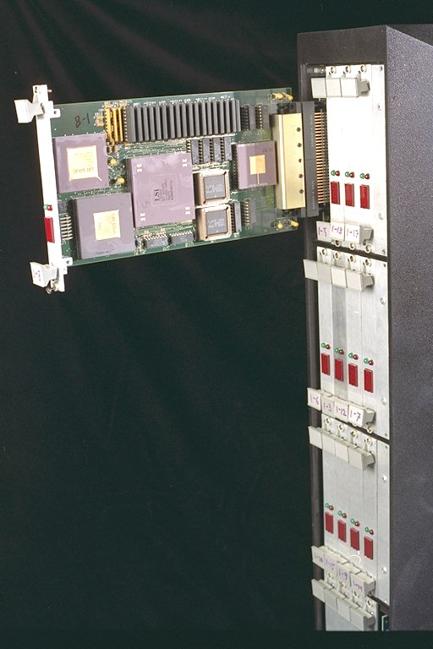
MIT Alewife (1990)
Modified SPARC chips
register windows hold different thread contexts
Up to four threads per node
Thread switch on local cache miss

Slide 14
IBM PowerPC RS64-IV (2000)
Commercial coarse-grain multithreading CPU
Based on PowerPC with quad-issue in-order five-stage pipeline
Each physical CPU supports two virtual CPUs
On L2 cache miss, pipeline is flushed and execution switches to second thread
short pipeline minimizes flush penalty (4 cycles), small compared to memory access latency
flush pipeline to simplify exception handling

Slide 15
Oracle/Sun Niagara processors
Target is datacenters running web servers and databases, with many concurrent requests
Provide multiple simple cores each with multiple hardware threads, reduced energy/operation though much lower single thread performance
Niagara-1 [2004], 8 cores, 4 threads/core
Niagara-2 [2007], 8 cores, 8 threads/core
Niagara-3 [2009], 16 cores, 8 threads/core
T4 [2011], 8 cores, 8 threads/core
T5 [2012], 16 cores, 8 threads/core
M5 [2012], 6 cores, 8 threads/core
M6 [2013], 12 cores, 8 threads/core
Notes:
Biancolin:
T4: First to use OoO (advertised 5x single-threaded improvement over T3)

Slide 16
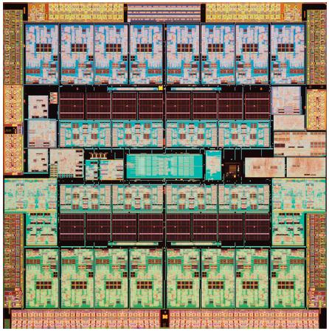
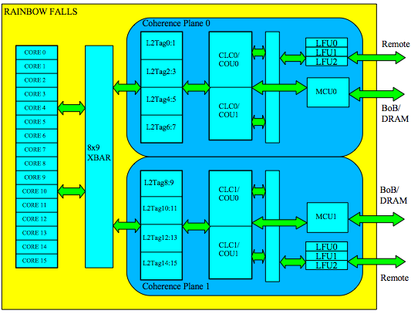
Oracle/Sun Niagara-3, “Rainbow Falls” 2009

Slide 17
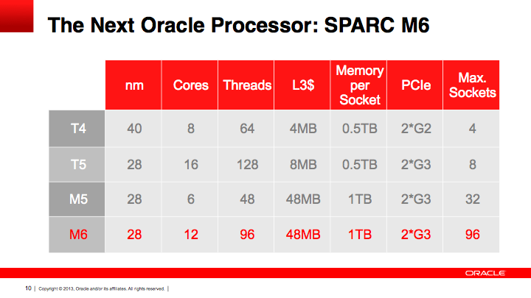
Oracle SPARC M6 Processor (2013)
Notes:
T4;

Slide 18
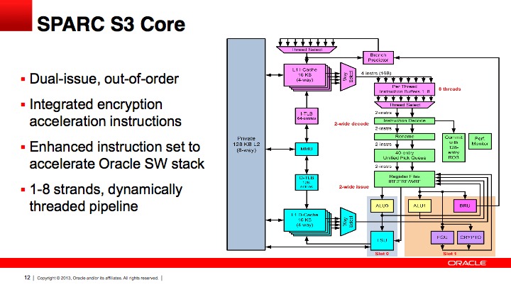
Oracle SPARC M6 Core (2013)

Slide 19
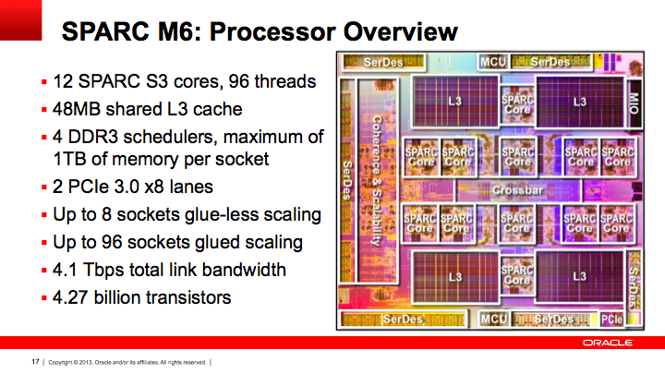
Oracle SPARC M6 (2013)
Oracle ended SPARC programs after M8 in 2017
Notes:
Biancolin: M8 (2017): 32 Sparc V9 cores; Quad issue; 8 threads per core; @ 5GHz Shared 256 KB L2 instruction cache (per four cores), private 128K L2 data cache per core 64 MB L3

Slide 20
CS152 Administrivia
PS 3 due today
PS 4 out Wednesday March 17, due Monday April 5
Lab 3 due Monday April 5
Midterm 1 regrade requests by Tuesday March 16 11:59PM
No lectures or sections next week!
Spring Break (March 22-26)

Slide 21
CS252 Administrivia
Readings on OoO architectures this Thursday

Slide 22
Simultaneous Multithreading (SMT) for OoO Superscalars
Techniques presented so far have all been “vertical” multithreading where each pipeline stage works on one thread at a time
SMT uses fine-grain control already present inside an OoO superscalar to allow instructions from multiple threads to enter execution on same clock cycle. Gives better utilization of machine resources.

Slide 23
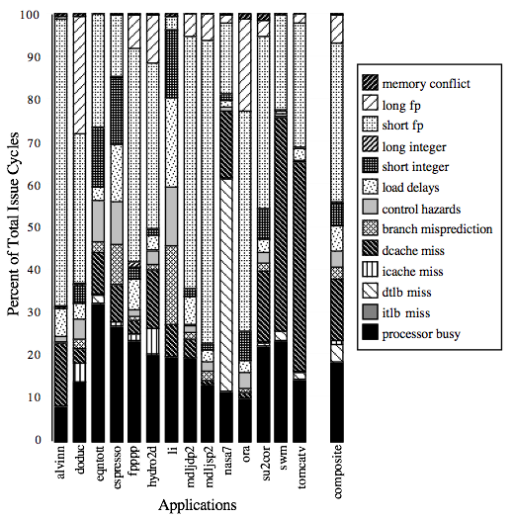
For most apps, most execution units lie idle in an OoO superscalar
For an 8-way superscalar.
From: Tullsen, Eggers, and Levy,
“Simultaneous Multithreading: Maximizing On-chip Parallelism”, ISCA 1995.

Slide 24
Superscalar Machine Efficiency
Issue width
Instruction issue
Completely idle cycle (vertical waste)
Time
Partially filled cycle, i.e., IPC < 4
(horizontal waste)
Notes:
Focus is switching to function unit efficiency (as a measure of throughput).

Slide 25
Vertical Multithreading
Issue width
Instruction issue
Second thread interleaved cycle-by-cycle
Time
Partially filled cycle, i.e., IPC < 4
(horizontal waste)
Cycle-by-cycle interleaving removes vertical waste, but leaves some horizontal waste
Notes:
Two flavours: Fine grained (per-vertical slot(cycle)) vs coarse-grained (multiple cycles)

Slide 26
Chip Multiprocessing (CMP)
Issue width
Time
What is the effect of splitting into multiple processors?
reduces horizontal waste,
leaves some vertical waste, and
puts upper limit on peak throughput of each thread.

Slide 27
Ideal Superscalar Multithreading [Tullsen, Eggers, Levy, UW, 1995]
Issue width
Time
Interleave multiple threads to multiple issue slots with no restrictions

Slide 28
O-o-O Simultaneous Multithreading [Tullsen, Eggers, Emer, Levy, Stamm, Lo, DEC/UW, 1996]
Add multiple contexts and fetch engines and allow instructions fetched from different threads to issue simultaneously
Utilize wide out-of-order superscalar processor issue queue to find instructions to issue from multiple threads
OOO instruction window already has most of the circuitry required to schedule from multiple threads
Any single thread can utilize whole machine

Slide 29
SMT adaptation to parallelism type
For regions with high thread-level parallelism (TLP) entire machine width is shared by all threads
For regions with low thread-level parallelism (TLP) entire machine width is available for instruction-level parallelism (ILP)
Issue width
Issue width
Time
Time
Notes:
Amdahl’s law…

Slide 30
Pentium-4 Hyperthreading (2002)
First commercial SMT design (2-way SMT)
Logical processors share nearly all resources of the physical processor
Caches, execution units, branch predictors
Die area overhead of hyperthreading ~ 5%
When one logical processor is stalled, the other can make progress
No logical processor can use all entries in queues when two threads are active
Processor running only one active software thread runs at approximately same speed with or without hyperthreading
Hyperthreading dropped on OoO P6-based followons to Pentium-4 (Pentium-M, Core Duo, Core 2 Duo), until revived with Nehalem generation machines in 2008.
First Intel Atom (in-order x86 core) has two-way vertical multithreading
Hyperthreading == (SMT for Intel OoO & Vertical for Intel InO)
Notes:
Load-store buffer in L1 cache doesn’t behave like that, and hence 15% slowdown.

Slide 31
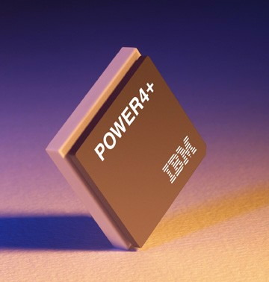
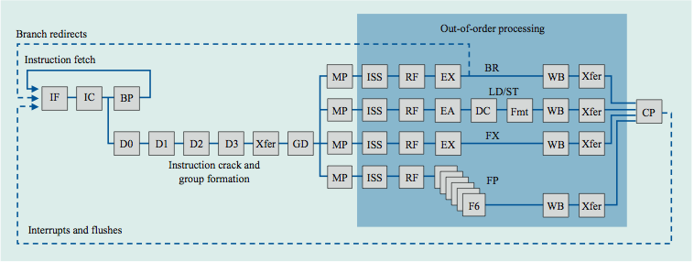
IBM Power 4
Single-threaded predecessor to Power 5.
8 execution units in out-of-order engine, each may issue an instruction each cycle.

Slide 32
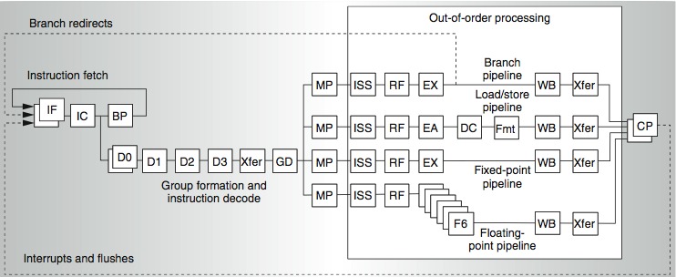
Power 4
2 commits (architected register sets)
Power 5
2 fetch (PC), 2 initial decodes

Slide 33
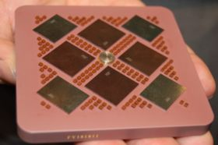
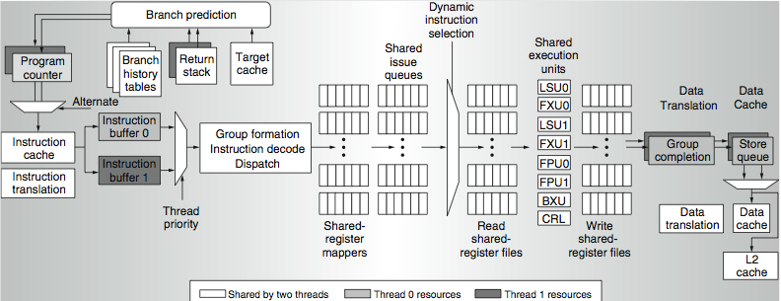
Power 5 data flow ...
Why only 2 threads? With 4, one of the shared resources (physical registers, cache, memory bandwidth) would be prone to bottleneck

Slide 34
Initial Performance of SMT
Pentium-4 Extreme SMT yields 1.01 speedup for SPECint_rate benchmark and 1.07 for SPECfp_rate
Pentium-4 is dual-threaded SMT
SPECRate requires that each SPEC benchmark be run against a vendor-selected number of copies of the same benchmark
Running on Pentium-4 each of 26 SPEC benchmarks paired with every other (26² runs) speed-ups from 0.90 to 1.58; average was 1.20
Power 5, 8-processor server 1.23 faster for SPECint_rate with SMT, 1.16 faster for SPECfp_rate
Power 5 running 2 copies of each app speedup between 0.89 and 1.41
Most gained some
Fl.Pt. apps had most cache conflicts and least gains

Slide 35
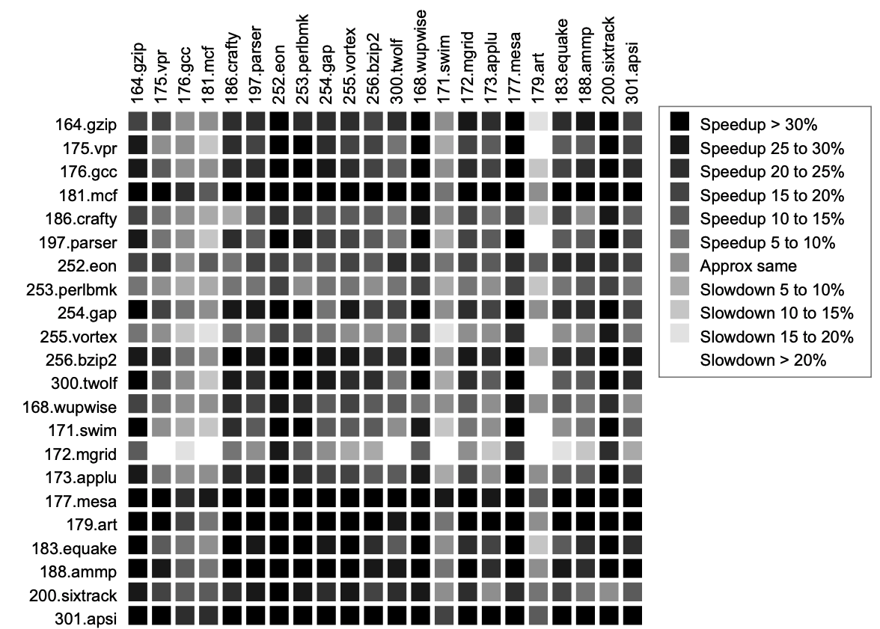
SMT Performance: Application Interaction
Your favorite benchmark from Lab2
Not affected by other programs
So long as they aren’t banging on the L2 too.
Bulpin et al, “Multiprogramming Performance of Pentium 4 with Hyper-Threading”

Slide 36
SMT Performance: Application Interaction
Your favorite benchmark from Lab2
Doesn’t play nice
Bulpin et al, “Multiprogramming Performance of Pentium 4 with Hyper-Threading”

Slide 37
SMT Performance: Application Interaction
Very sensitive to second program
Bulpin et al, “Multiprogramming Performance of Pentium 4 with Hyper-Threading”

Slide 38
Icount Choosing Policy
Fetch from thread with the least instructions in flight.
Why does this enhance throughput?
Notes:
Fetch unit that can keep up with the simultaneous multithreaded execution engine
have the fewest instructions waiting to be executed
making the best progress through the machine
40% increase in IPC over RR
Don’t want to clog instruction window with thread with many stalls ➔ try to fetch from thread that has fewest insts in window

Slide 39
SMT & Security
Most hardware attacks rely on shared hardware resources to establish a side-channel
Eg. Shared outer caches, DRAM row buffers
SMT gives attackers high-BW access to previously private hardware resources that are shared by co-resident threads:
TLBs: TLBleed (June, ‘18)
L1 caches: CacheBleed (2016)
Functional unit ports: PortSmash (Nov, ’18)
OpenBSD 6.4 → Disabled HT in BIOS, AMD SMT to follow

Slide 40
Summary: Multithreaded Categories
Simultaneous
Multithreading
Time (processor cycle)
Superscalar
Fine-Grained
Coarse-Grained
Multiprocessing
Thread 1
Thread 3
Thread 5
Thread 2
Thread 4
Idle slot

Slide 41
Acknowledgements
This course is partly inspired by previous MIT 6.823 and Berkeley CS252 computer architecture courses created by my collaborators and colleagues:
Arvind (MIT)
Scott Beamer (UCB)
Joel Emer (Intel/MIT)
James Hoe (CMU)
John Kubiatowicz (UCB)
David Patterson (UCB)

